Slide 1
Invigilating Cambridge International Education exams 2025
A training presentation for exams officers to train invigilators
Presenter name(s)
Date and time
Notes:
***Add your name and date of the presentation***

Slide 2

Contents
Invigilator role and responsibilities
Key concepts
Dealing with the unexpected
Before the exam
During the exam
At the end of the exam
Notes:
Contents of the training – add your own points if you need to.

Slide 3
Invigilator role and responsibilities
Notes:
Section break – the next few slides are about the role and responsibilities of the invigilator.

Slide 4
What is an invigilator?
Invigilators are the people in the exam room responsible for the conduct of an exam.
You:
  make sure the exam follows Cambridge International Education regulations so that candidates can show what they know and can do
  keep the exam secure before, during and afterwards
  prevent and report suspected malpractice
  prevent administrative errors.

Slide 5
Why we need invigilators
Invigilators are important for many reasons:
You:
  give candidates a fair and consistent exam experience across the world
  make sure exams are conducted the same way every time, regardless of where or when they are happening
  identify and prevent security breaches of exam material
  stop administrative errors which have the potential to disadvantage candidates.

Slide 6
Your responsibilities as an invigilator
As an invigilator you must:
  understand the regulations in sections 4 and 5 of the Cambridge Handbook
  understand the Key Time and Full Centre Supervision regulations
  be familiar with the Notice to Candidates and Candidate Warning poster
  understand any specific regulations relating to the subjects being examined
  give your full attention to the conduct of the exam and move around the room
  tell the Head of Centre if you suspect malpractice.
Notes:
***Make sure you have access to the Cambridge Handbook 2025, sections 4 and 5 (abridged document), Key times and Full Centre Supervision sections and candidate posters for invigilators to see***
As an invigilator you must also make sure you:
give all your candidates the same exam experience
know how to deal with the unexpected
help organise candidates at the start and end of the exam
provide the correct information and material for each exam, helping prevent administrative errors
be clear about the times and days you are working
arrive on time
carry identification
dress appropriately.
Mention and delete above as appropriate.

Slide 7
Number of invigilators
Circumstance | Number of invigilators
Separate invigilation | For candidates with specific needs in a separate room: 1 invigilator to 1 candidate
All other exams (including art & design) | At least 1 invigilator to 30 candidates
Full Centre Supervision | At least 1 supervisor to 30 candidates

Slide 8
Number of invigilators
Circumstance | Number of Invigilators
ICT tests | Minimum of 1 invigilator even if under 20 candidates At least 1 invigilator to 20 candidates At least one invigilator should be a subject specialist 1 suitably trained supervisor
Science practical tests | Minimum of 2 invigilators even if under 20 candidates Increase by 1 invigilator to 20 candidates 1 suitably trained supervisor
Notes:
For ICT tests:
On the day of the exam, you must have one invigilator for every 20 candidates.
At least one invigilator should not have been involved in teaching or preparing the candidates for the exam.
You must also have a suitably experienced supervisor in the test room to deal with technical difficulties.
The supervisor can have taught or prepared the candidates for the test.
The supervisor is not an invigilator.
We recommend you have an extra technician available near the exam in case of technical issues.
For science practicals:
You must have at least two invigilators in the exam room and then increase by one invigilator to every 20 candidates.
There should also be a supervisor who sets up the room and must be there at the start of the exam. This can be an invigilator if they do not also have to conduct the exam.
Ideally another invigilator should be a specialist in the subject being examined.
The supervisor must report anything that could disadvantage the candidate for example if a piece of equipment is faulty.

Slide 9

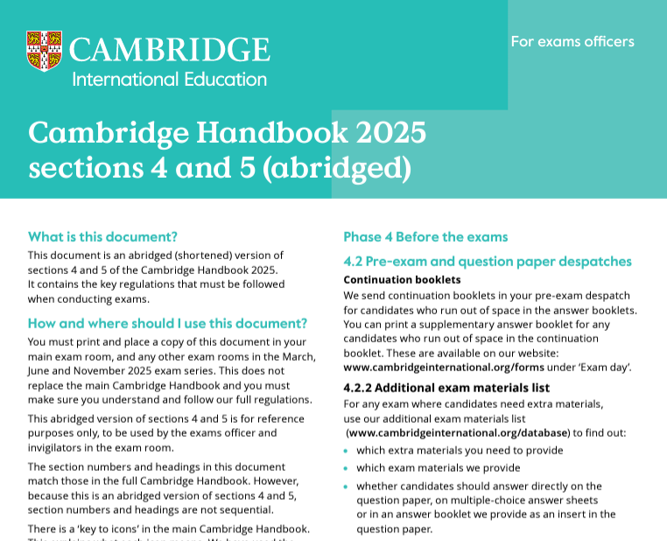
What you need in the exam room
Notes:
Cambridge Handbook 2025: section 4 and 5 (abridged)
This document is an abridged (shortened) version of sections 4 and 5 of the Cambridge Handbook 2025. It contains the key regulations that must be followed when conducting exams and is for reference purposes only. There must be a printed copy of this document in your main exam room, and any other exam rooms.
Cambridge Handbook 2024: Key Times and Full Centre Supervision
This document is the Key Times and Full Centre Supervision section of the Cambridge Handbook 2025. It contains key regulations that must be followed when conducting exams. There must be a printed copy of this document in your main exam room, and any other exam rooms.

Slide 10
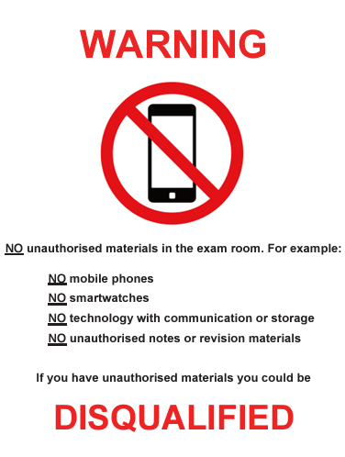
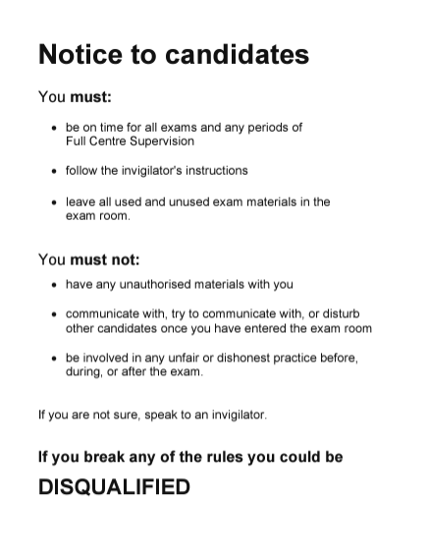
What you need in the exam room
Notes:
Candidate Warning poster (inside and outside the exam room)
Notice to Candidates poster (inside and outside the exam room)

Slide 11
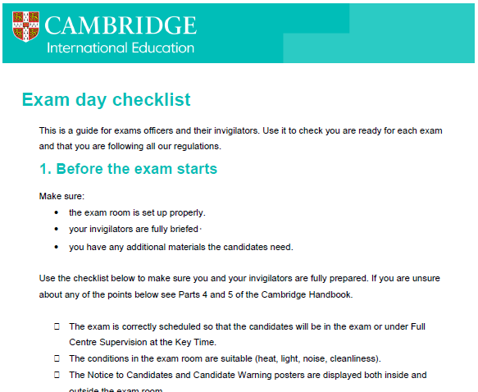
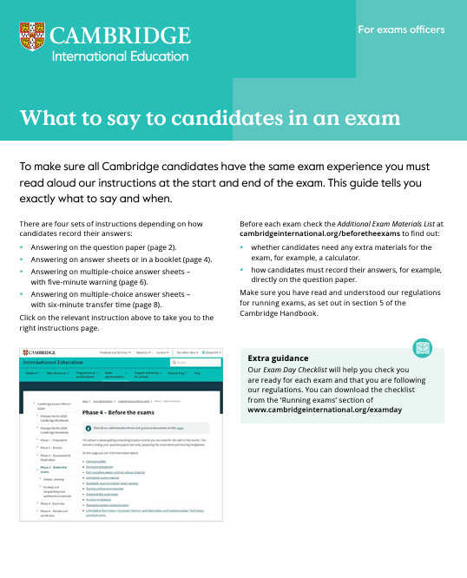
What you need in the exam room
Notes:
Exam Day Checklist
A guide for exams officers and their invigilators. Use it to check you are ready for each exam and that you are following all our regulations. Available at www.cambridgeinternational.org/examday
What to Say to Candidates in an Exam document
To make sure all candidates have the same exam experience you must read aloud our instructions at the start and end of the exam. This document tells you exactly what to say and when. Available at www.cambridgeinternational.org/examday

Slide 12
Differences between Cambridge International Education and JCQ exam boards
Cambridge International Education
Five-minute warning
Posters inside and outside the room
Key Times
Full Centre Supervision
Keep empty question paper packets
Separate inspections
JCQ
Five-minute warning allowed but not required
Posters outside the room
Start times
No Full Centre Supervision
Do not keep empty question paper packets
Notes:
***UK information only – delete this slide if not relevant***
Cambridge International Education is not a member of JCQ and therefore does not follow the same regulations as JCQ. These are the main differences between Cambridge International Education exams and JCQ:
Five-minute warning – Cambridge International Education states you must give candidates a five-minute warning before the end of their exam. JCQ allows a five-minute warning, but does not require this.
Posters inside and outside the room – Cambridge International Education posters should be displayed inside and outside all exam rooms. JCQ only requires posters to be displayed outside. To make things easier, you can display JCQ posters outside and Cambridge posters inside.
Key Times – Cambridge International Education operates a security system called Key Times rather than start times like JCQ.
Full Centre Supervision – Cambridge International Education candidates must be supervised if they start their exam after the Key Time or end their exam before the Key Time. JCQ does not require this.
Keep question paper packets – You must keep all question paper packets until certificates are released. This is a security measure. JCQ does not request this.
Separate inspections – Because Cambridge International Education is not a member of JCQ, there is no data sharing, so Cambridge carries out its own inspections.
See the UK supplement to the Cambridge Handbook, available at www.cambridgeinternational.org/eoguide, for more information.

Slide 13
Key concepts
Notes:
Section break – the next few slides are about the main concepts invigilators must understand.

Slide 14
Who is in an exam
Exams officer
The person with specific responsibility for administering Cambridge exams
Invigilator
(sometimes known as supervisor)
The person in the exam room responsible for the conduct of an exam
Candidate
The person who is entered for an exam
Notes:
The invigilator and supervisor can be the same person. An invigilator is in the exam, a supervisor is in Full Centre Supervision.

Slide 15
Access arrangements
Word processor
Human reader
Extra time
Supervised rest breaks
Scribe
Modified Papers
Prompter
Cambridge Handbook section 1.3
The exams officer will tell you if there are any candidates using access arrangements in an exam
Notes:
***Add centre-specific information here regarding access arrangements if you have them, e.g. separate rooms***
If a candidate needs extra support during their exam due to a pre-existing physical or learning difficulty, certain arrangements can be put in place.
These are called access arrangements.
Examples include:
Word processor – when a candidate has a disability that affects their ability to write.
Human reader – when a candidate has a person to read the questions to them.
Extra time – when a candidate gets more time to complete the exam.
Supervised rest breaks
Scribe – when a candidate has a person to write their answers for them.
Modified papers – when a candidate is given papers in a different format.
Prompter – when a candidate finds it difficult to concentrate or time keep in an exam.
Practical assistant – when a candidate has a physical disability and needs support in practical exams.

Slide 16
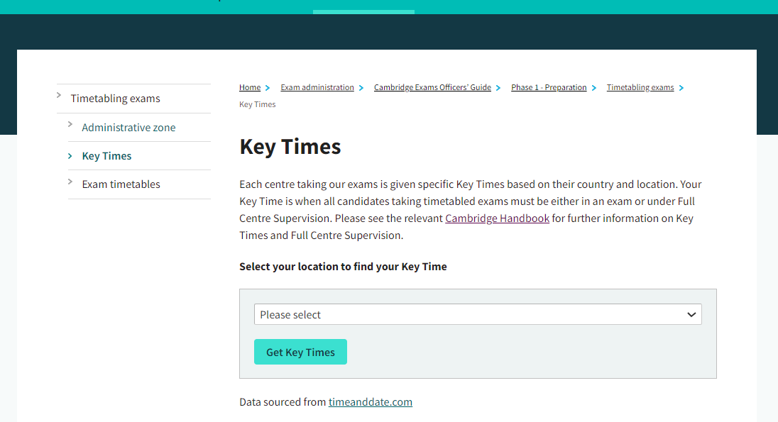
Key Times – What are they?
Key Times are a defined point in a timetabled session when candidates must be in the exam or under Full Centre Supervision.
Cambridge specifies the Key Times.
Our Key Times are based on our centre’s location.
Notes:
***Give invigilators your Key Time information***
Cambridge exams are run in different time zones across the world. Key Times make sure the exams stay secure and that candidates cannot communicate information about the exam until everyone in the world has completed it.
If a candidate finishes early and wants to leave the room before the Key Time, they need to be kept under Full Centre Supervision until the Key Time has passed.
Watch the Key Times video and identify your centre’s Key Times at: www.cambridgeinternational.org/timetablingexams
*** Please update image with screenshot with your administrative zone’s key time***
See the Key Times and Full Centre Supervision section of the Cambridge Handbook.

Slide 17

Key Times – Why are they important?
Key Times are important because they prevent confidential exam information being shared:
  with our candidates before their exams, or
  by our candidates after their exams.
  Everyone involved in administering and conducting exams must understand and correctly implement Key Times and Full Centre Supervision.
Notes:
***Give invigilators your Key Time information***
Cambridge International Education exams are run in different time zones across the world. Key Times make sure the exams stay secure and that candidates cannot communicate information about the exam until everyone in the world has completed it.
If a candidate finishes early and wants to leave the room before the Key Time, they need to be kept under Full Centre Supervision until the Key Time has passed.
Watch the Key Times video and identify your centre’s Key Times at: www.cambridgeinternational.org/timetablingexams
See the ‘Key Times and Full Centre Supervision’ section of the Cambridge Handbook.

Slide 18



Full Centre Supervision
Candidates can:
be kept under Full Centre Supervision in the exam room or any other suitable room
have access to books and revision notes during Full Centre Supervision
talk to each other, as long as they do not disturb other candidates
Notes:
Full Centre Supervision is a defined type of supervision for candidates that is conducted by trained members of staff.
If candidates are not in their exam at the Key Time they must be under Full Centre Supervision.
This means that they must be supervised. All candidates must be supervised at a ratio of 1 supervisor to 30 candidates.
If a candidate leaves the room they must be accompanied by a supervisor (the correct ratios of supervisors to candidates must still be in place in the Full Centre Supervision room).
See the ‘Key Times and Full Centre Supervision’ section of the Cambridge Handbook.
Full Centre Supervision can take place in the exam room or in another suitable room, candidates can have access to their books and notes, and they are allowed to talk to each other as long as this doesn’t affect any other candidates who are taking exams.

Slide 19


Full Centre Supervision
Candidates must not:
communicate with anyone who is not under Full Centre Supervision or anyone who has already sat the exam
have access to any communication device with or without access to the internet
Notes:
They are not allowed any access to communication devices with or without access to the internet, such as mobile phones or smart watches, or to communicate with anyone who is not under Full Centre Supervision or anyone who has already sat the exam.

Slide 20
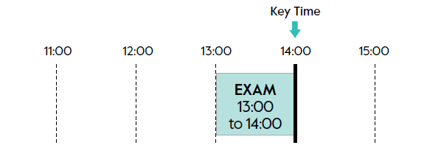
Key Time scenario 1
Is Full Centre Supervision required in this scenario?
Notes:
***Key Times concept check – please do not delete this***
The Key Time is an example and may not match your centre’s Key Time.
Answer: The exam finishes at the Key Time, which means once all the exam material has been collected and collated, candidates can leave the exam room and do not need to be supervised once they have left.

Slide 21
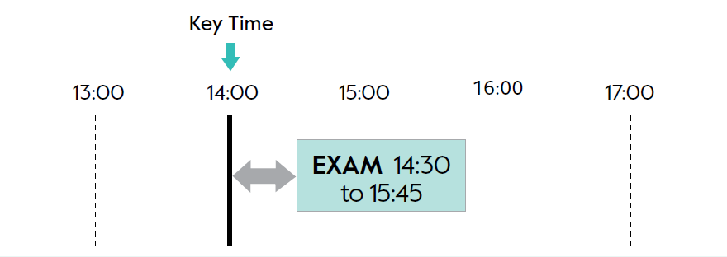
Key Time scenario 2
Is Full Centre Supervision required in this scenario?
Notes:
***Key Times concept check – please do not delete this***
The Key Time is an example and may not match your centre’s Key Time.

Slide 22
Key Time scenario 2 - answer
Is Full Centre Supervision required in this scenario?
Notes:
***Key Times concept check – please do not delete this***
The Key Time is an example and may not match your centre’s Key Time.
Answer: Full Centre Supervision is required in this scenario because the exam starts after the Key Time. Therefore, it is possible that candidates in another part of the world have already taken the exam and so could pass on information. Candidates must be supervised from 14:00 until the exam starts. Once the exam is over and they are dismissed, they do not have to be supervised.

Slide 23
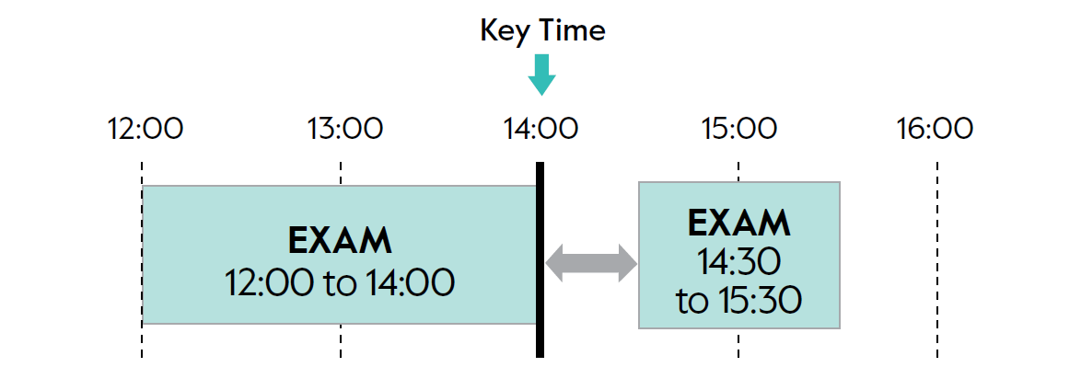
Key Time scenario 3
Notes:
***Key Times concept check – please do not delete this***
The Key Time is an example and may not match your centre’s Key Time.

Slide 24
Key Time scenario 3 - answer
Notes:
***Key Times concept check – please do not delete this***
The Key Time is an example and may not match your centre’s Key Time.
Answer: Full Centre Supervision is required in this scenario. In this situation, two exams scheduled for the same session are being run one after the other. Candidates must be supervised before the start of the second exam. If candidates are only taking the first exam, those candidates are allowed to leave the exam room at the end of the exam as they have met the Key Time regulations. If candidates are taking both exams, they must be supervised between the exams. If candidates are only taking the second exam, they must be supervised from the Key Time, as with the previous example.

Slide 25
Dealing with the unexpected
Notes:
Section break – the next few slides are about dealing with the unexpected.

Slide 26
Late arrivals
Late before the Key Time:
  You can decide to allow the candidate into the exam.
  You do not need to tell the exams officer.
Late after the Key Time:
  You can decide to allow the candidate into the exam.
  Warn them Cambridge may not accept their script.
  Record the reason for being late, plus arrival, start and finish times.
  Tell the exams officer.
Late after the exam has finished:
  Do not allow the candidate to take the exam.
  You do not need to tell the exams officer.
Notes:
Section 5.1.10 of the Cambridge Handbook has more detailed information on late arrivals – remind invigilators they will have this in the exam room to refer to.
A candidate is a ‘late arrival’ if they arrive:
after an exam has started
after a period of Full Centre Supervision has started.
If a candidate arrives late but before the Key Time:
You can decide whether to allow the candidate to take the exam. If they take it allow the full time.
You do not need to tell the exams officer about this late arrival.
If a candidate arrives late, after the Key Time but during the exam or a period of Full Centre Supervision:
If the exam is still in progress, you can decide whether to allow the candidate to take the exam. If they take it allow the full time.
If a candidate arrives late for a period of Full Centre Supervision before an exam, but it is after the Key Time, you can decide whether to allow them to take the exam.
If the candidate arrives after the Key Time and you allow them to take the exam you must tell them that:
you are reporting their late arrival to Cambridge
Cambridge will mark their answer script, however, they may not accept their script and the candidate may get ‘NO RESULT’ in the syllabus.
Keep a record of all the information to give to the exams officer so they can report it to Cambridge.
If a candidate arrives late, after the Key Time, after the exam has finished:
Do not allow the candidate to take the exam. Mark the candidate as absent on the attendance register.
You do not need to tell the exams officer about this late arrival.

Slide 27
Emergency situations
If there is an emergency during an exam, the safety of candidates and staff is the most important thing.
In an evacuation, if it is safe to do so:
  make sure all question papers and answer scripts are left in the exam room
  secure the exam room
  supervise candidates so they cannot communicate with anyone or access information.
Keep a record and report what has happened to the exams officer.
Notes:
Section 5.2.5 of the Cambridge Handbook has more information about this for invigilators to refer to.
In an emergency the safety of candidates and staff is the most important thing.
If it is safe and practical, invigilators should do the following to keep the exam secure:
If necessary evacuate the exam room.
Fully supervise candidates so they cannot communicate with anyone or access information.
Make sure all question papers and answer scripts are left in the exam room and that the room is secured.
After the candidates have returned to the exam room and before the exam restarts, mark on the candidates’ work where the interruption happened, if possible.
Note the time and length of the interruption.
Allow candidates the full working time for the exam.
If there are only a small number of candidates, you could take them to another room to finish the exam. Also take the question papers and scripts.
Tell the exams officer what has happened so they can report it to Cambridge : info@cambridgeinternational.org

Slide 28
Malpractice
Malpractice is any action that breaks Cambridge International Education regulations and potentially threatens the integrity of their exams and certificates. Malpractice can happen before, during or after timetabled exams or other assessments.
Malpractice can be:
  intentional and aim to give an unfair advantage in an exam or assessment
  caused by people being careless, forgetful or unaware of the regulations
  beyond anyone's control and be a result of circumstance.
A variety of individuals could be involved in malpractice, for example:
  candidates
  centre staff
  other people.
Notes:
Section 5.6 of the Cambridge Handbook has more information about malpractice, including what to do if you discover malpractice.
Malpractice is any action that breaks Cambridge International Education regulations and potentially threatens the integrity of their exams and certificates.
Malpractice can happen before, during or after timetabled exams or other assessments.
Malpractice can be intentional and aim to give an unfair advantage in an exam or assessment but it can also be caused by people being careless, forgetful or unaware of the regulations.
A variety of individuals could be involved in malpractice, for example candidates or centre staff (for example, teachers, invigilators, exams officers, management, etc.), but also other people (for example, relatives or friends of the candidates).

Slide 29
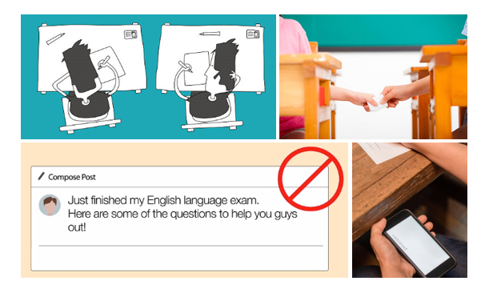
Malpractice
Notes:
Section 5.6 of the Cambridge Handbook has more information about malpractice, including what to do if you discover malpractice.
It is really important that all invigilators understand what constitutes malpractice and know how and when to report any suspicions about the security of question papers or the conduct of any exam.
Examples of candidate malpractice are:
bringing unauthorised materials into the exam room (for example notes, smart watches, mobile phones – any materials candidates could use to conceal or access information in the exam room)
disruptive behaviour in the exam room (including talking or attempting to talk to other candidates and/or using offensive language)
copying from another candidate
collusion
looking for, getting, receiving, exchanging or passing on confidential or fake exam material in any way.
Some examples of centre staff malpractice:
giving candidates the answer in an exam
opening question paper packets before the exam
not storing exam material securely
not keeping appropriate records.

Slide 30
Special consideration
Special consideration is a change made to a candidate's mark after an exam. This will be because something unexpected and adverse happened to the candidate.
Circumstances can include:
  illness
  bereavement
  temporary injury.
Talk to the exams officer if you think a candidate is eligible for special consideration.
Notes:
Section 5.5 of the Cambridge Handbook has more detailed information about special consideration, including what special consideration is not.
If an invigilator thinks a candidate might be eligible for special consideration, ask them to talk to the exams officer.

Slide 31
Before the exam
Notes:
Section break – the next few slides are about before the exam.

Slide 32
Centre-specific information
*** Add appropriate information here***
Notes:
***Add information to this slide as appropriate for your centre***
Ideas for this slide:
Invigilator schedules:
How many exams will they invigilate?
When will they receive their timetable?
Will there be briefings before each exam?
Signing in before an exam.
Telling the exams officer you have arrived.
What to do if you can no longer invigilate.
Invigilator briefings (if you have them).

Slide 33
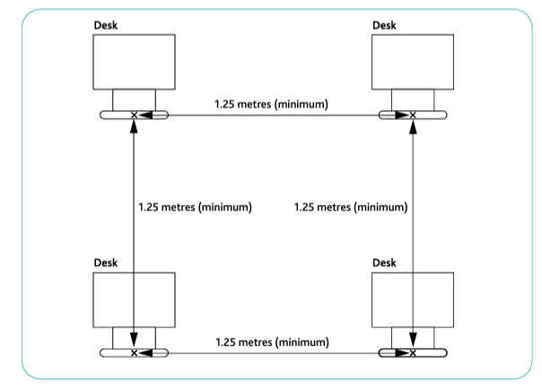
Preparing the room
Notes:
To give all candidates the same experience each room needs to be set up in exactly the same way:
desks a minimum of 1.25 metres apart in all directions
no helpful display material visible
a clock that all candidates can see, which shows the actual time
appropriate heating, lighting and ventilation
noise levels outside the exam room at a minimum
centre number, date, actual start and finish time of each exam, syllabus and component code of each exam
Notice to Candidates and Candidate Warning posters outside and inside the room.

Slide 34
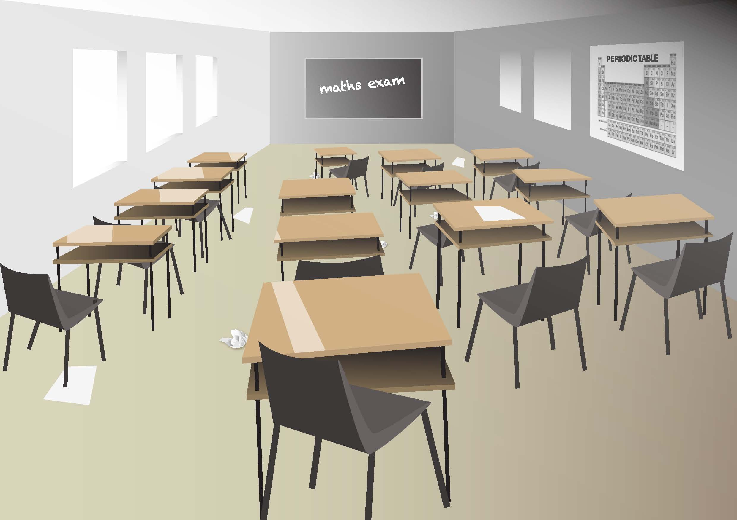
What is wrong with this exam room?
Notes:
What is wrong with this exam room?
See if you can find eight things wrong with this room.

Slide 35
What is wrong with this exam room?
Notes:
What is wrong with this exam room?
See if you can find eight things wrong with this room.
Answers
Incomplete information on the board. All candidates should be able to see:
the centre number
date
syllabus and component information of the exam
the actual start and finish time of the exam.
There is potentially helpful display material on the wall.
The Notice to Candidates and Candidate Warning posters are not displayed.
Bright sunlight is coming through the windows, which may cause candidates difficulty.
The desks are not set up according to Cambridge regulations.
There is rubbish on the floor and the room is generally untidy (two circles).
There is no clock.
The desks have shelves underneath – while Cambridge regulations do not exclude the use of these desks, we would recommend that alternatives are used if available. If not, invigilators must be very vigilant and make sure candidates are not storing unauthorised items on the shelves.

Slide 36
Candidates
Before candidates enter:
  Check the exam room is set up properly.
  Check you have everything prepared.
When candidates enter:
  Remove all unauthorised materials and items.
  Complete the attendance register.
  Check the identity of the candidates.
When candidates are seated:
  Make sure they are sitting in the correct place.
  Make sure they have all the items they need.
Notes:
Section 5.1 of the Cambridge Handbook has more detailed information about what to do at the beginning of the exam.
Before candidates enter:
Is the exam room set up correctly?
Do you have the right question papers and candidate materials?
Do you have the attendance register?
Is there the right number of invigilators?
Do you have a tested method of calling for assistance?
Is your mobile phone on silent mode and away from candidates?
Do you have the Exam Day Checklist ready to complete?
Do you have the read-aloud document for the start and end of the exam called What to Say to Candidates in an Exam?
When candidates enter:
Tell them that the exam is in progress as soon as they enter the room.
Seat them using the seating plan provided.
Complete the attendance register and tell the exams officer if any candidates are not there.
Check the identification of each candidate.
Remove any unauthorised materials from candidates and place the unauthorised materials outside the exam room.
When candidates are seated:
Make sure candidates are seated according to your seating plan.
Check that they have the items they need for the exam.

Slide 37

Starting the exam
Before opening the question paper packets, two invigilators must check:
  that the blue question paper packet is not damaged
  that they have the correct blue question paper packet
  that the information in the transparent inner bag is correct.
Notes:
Section 5.1.9 of the Cambridge Handbook has more information about this for invigilators to refer to in the exam.
When the candidates are seated, two members of staff must check that the blue question paper packet is undamaged and that they have the correct blue question paper packet. This includes checking the centre number, exam date, session, subject title, syllabus and component number are correct. Once they have completed these checks they can open the outer blue packaging.

Slide 38
Starting the exam
When checks have been completed you can open the transparent bag and hand out the question papers. Contact the exams officer immediately if there are any problems.
Read the instructions for starting the exam in the What to Say to Candidates in an Exam document.
Tell candidates to write their name, candidate number and centre number on any work they want to hand in.
Start the exam.
Notes:
Section 5.1.9 of the Cambridge Handbook has more information about this for invigilators to refer to in the exam.
An exam is in progress from the time the candidates enter the room until all the scripts have been collected.
The front cover of the question paper will be visible through the transparent inner bag. Two members of staff must check again that the day, date, time, subject and component are correct. They should make a final check to make sure that the packet is undamaged before opening it and handing out the question papers to candidates.
You must read out a set of instructions before candidates are allowed to start working. The instructions are in the What to Say to Candidates in an Exam document or in the script provided to you by the exams officer.
You must read out all instructions in English. You can then repeat them in another language as long as the content and meaning are exactly the same.
Tell candidates to write their name, candidate number and centre number on any work they want to hand in. For listening tests, make sure candidates are given time to do this before the invigilator plays the CD or audio file.
You must tell candidates about any erratum notices.

Slide 39
During the exam
Notes:
Section break – the next few slides are about during the exam.

Slide 40
During the exam
Remain alert and move around to see all candidates.
Do not try and complete other tasks while in the exam room.
Look out for malpractice.
Respond to requests to leave the room.
Do not give advice to candidates on the content of the exam.
Remove disruptive candidates.
Maintain the required number of invigilators in the room.
Call for help if necessary.
Notes:
Section 5.2 of the Cambridge Handbook has more information for invigilators to refer to.
During the exam all invigilators must remain alert, move around the room and supervise the candidates to make sure they do not cheat or distract other candidates.
Do not try and complete other tasks at the same time, such as marking or reading.
Respond as quickly as possible when a candidate raises their hand for help:
Only answer questions about information on the front of the paper.
Do not give any advice to the candidate about the content of the question paper – check with the exams officer if you are not sure.
Look out for any malpractice or candidates looking unwell. Be particularly vigilant for candidates who may be trying to use hidden electronic communication devices such as smart watches or earpieces.
If a candidate is disruptive remove them from the room while you resolve the issue.
Remember to maintain the required number of invigilators.

Slide 41
Calling for help
***Add centre-specific information here***
Notes:
***Add centre-specific information for how invigilators can get extra help if they need to for whatever reason***
Regulations in the 2025 Cambridge Handbook:
4.6 (g) Apart from one device to ask for help, invigilators must not have access to any other form of communication while in the exam room.
4.6 (i) (ii) Invigilators must be able to ask for help easily, without leaving the exam room or disturbing candidates. Invigilators can have a mobile phone in the exam room for this purpose only. They must keep the phone on silent mode and away from candidates.

Slide 42


Candidates leaving the room
Candidates are allowed to go to the washroom during the exam.
  An invigilator of the appropriate gender must accompany them.
  Invigilator numbers must be maintained in the exam room – call for extra support if necessary.
A candidate can choose to finish the exam early and not return.
  Collect all exam material from them before they leave.
  Keep candidates under Full Centre Supervision if the Key Time has not passed.
Notes:
Section 5.2.3 of the Cambridge Handbook has more information for invigilators to refer to during the exam.
If candidates need to use the washroom during the exam, they must be accompanied by a member of staff.
This can be an invigilator as long as the ratio of invigilators to candidates is maintained.
If a candidate has finished their exam early and wants to leave the exam room and not return, the following regulations apply:
Before any candidate leaves the exam room, you must collect their answer script and question paper.
Candidates can be allowed to leave the exam room but must be kept under Full Centre Supervision until the Key Time has passed.
After the Key Time the candidate can leave the exam room and does not need to be under Full Centre Supervision.
If you prefer you can keep the candidate in the exam room until the end of the exam but you must keep them under exam conditions.

Slide 43
At the end of the exam
Notes:
Section break – the next few slides are about the end of the exam.

Slide 44





At the end of the exam
Collect the answer scripts and question papers, and check they are all accounted for.
If the Key Time has passed allow candidates to leave.
If the Key Time has not passed keep candidates under Full Centre Supervision.
Make sure candidates do not disturb other candidates still taking exams.
Candidates must not remove any question papers or question paper content from the exam room.
Notes:
Section 5.3 of the Cambridge Handbook has more information on ending the exam for invigilators to refer to.
Candidates must stay seated until you have collected, and accounted for, all the question papers, scripts and any additional continuation sheets.
If the Key Time has passed candidates can leave the room when you have collected all the exam materials.
If the Key Time has not passed candidates must be kept under Full Centre Supervision, either in the exam room or in another suitable room.
Dismiss the candidates row by row, in silence to make sure no other candidates are disturbed.
Candidates must not remove any question papers or question paper content from the exam room.

Slide 45
Sorting and packing scripts
Sort the scripts into the order shown on the attendance register.
Do not leave scripts unattended at any time.
Do not read or allow anyone else to read any of the scripts.
Collect any unused stationery or equipment.
Hand the scripts and attendance registers to the exams officer immediately for despatch.
Notes:
Section 5.3 of the Cambridge Handbook has more information on ending the exam for invigilators to refer to.
After you have dismissed the candidates:
Sort the scripts into the order shown on the attendance register.
Do not leave scripts unattended at any time.
Do not read or allow anyone else to read any of the scripts.
Collect any unused stationery or equipment.
Hand the scripts and attendance registers to the exams officer immediately for despatch.
Hand the empty question paper packets to the exams officer to keep.
If the same exam is taking place in different rooms, invigilators from the smaller rooms should place the scripts in an envelope. This does not need to be sealed. They should take the scripts to be collated with the scripts from the other rooms. Or one invigilator can collect the scripts from the different rooms. Exam scripts must be sealed in the exam room.

Slide 46
Reporting to the exams officer
***Add centre-specific information here***
Notes:
***Edit this slide to include centre-specific information on how you want invigilators to report anything to you about the exams***
Ideas for this slide:
Will you have a debrief at the end of each exam?
How would you like invigilators to tell you about late candidates, malpractice, special consideration, anything else out of the ordinary?

Slide 47
Any questions?
© Cambridge University Press and Assessment 2025

Slide 48
Thank you!
Thank you for listening!
www.cambridgeinternational.org/examsofficers
© Cambridge University Press and Assessment 2025

